Slide 1
History Department
Program Review Presentation
Cohort 1: 2018-2019

Slide 2
History Department Profile
AA-T Degree
Guided Pathway
Rich Curriculum
Nurture:
Cultural awareness
Culturally competent & inclusive college community
Critical thinking & creative planning
Notes:
Describe what your program does and how this fits with the mission of ARC

Slide 3
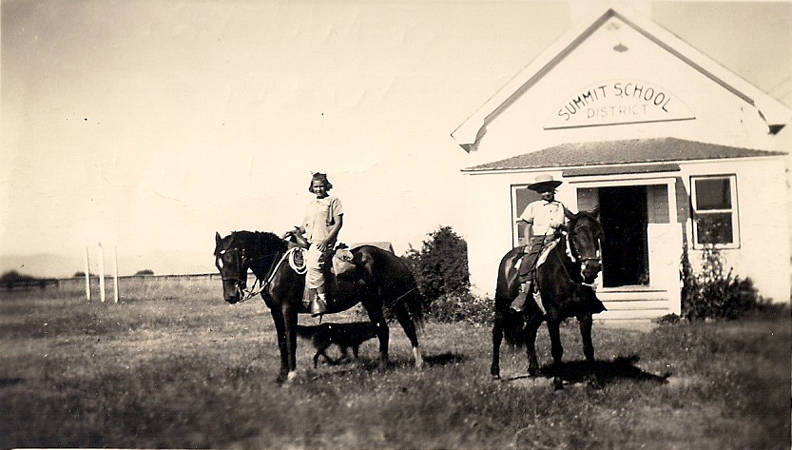
Historical Analysis
Program Strengths:
Our faculty
Breadth and depth of curriculum
Program Challenges:
Disproportionately impacted students
Course cancellations
Notes:
List your program’s strengths and challenges based on review of your historical data or other records.

Slide 4
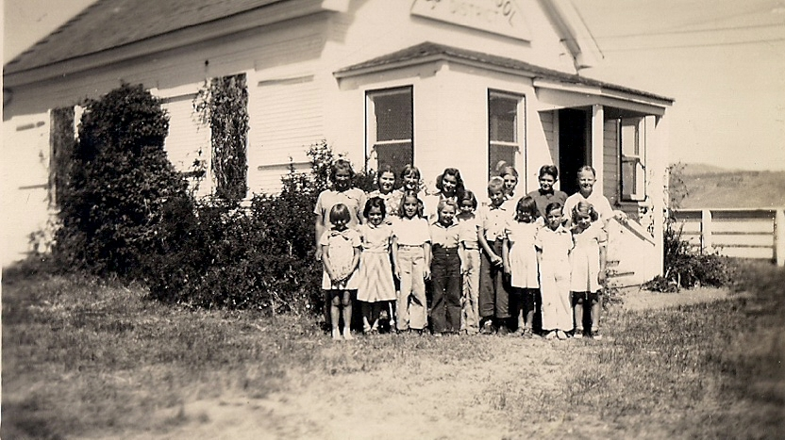
Objectives
Request and process data
Protect our culturally rich curriculum
Strategic scheduling & publicity
Focus on pedagogy and syllabus revisions
Equity sub-committee
Academic skills
Mission Vision Values
Notes:
List what your program wants to accomplish. Discuss how these accomplishments will or do support the ARCmission.

Slide 5
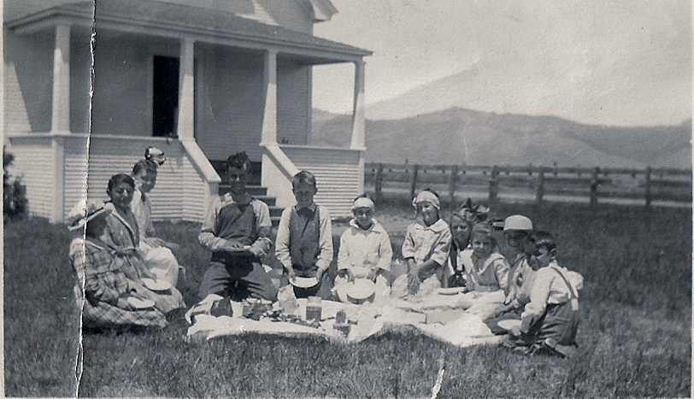
Strategic Enhancement
Secure schedules
Improved success rates
Plan new learning spaces
Smaller class sizes
Notes:
Describe what your program’s ideal future looks like. Discuss how this vision supports ARC’s commitment to social justice and equity.

Slide 6
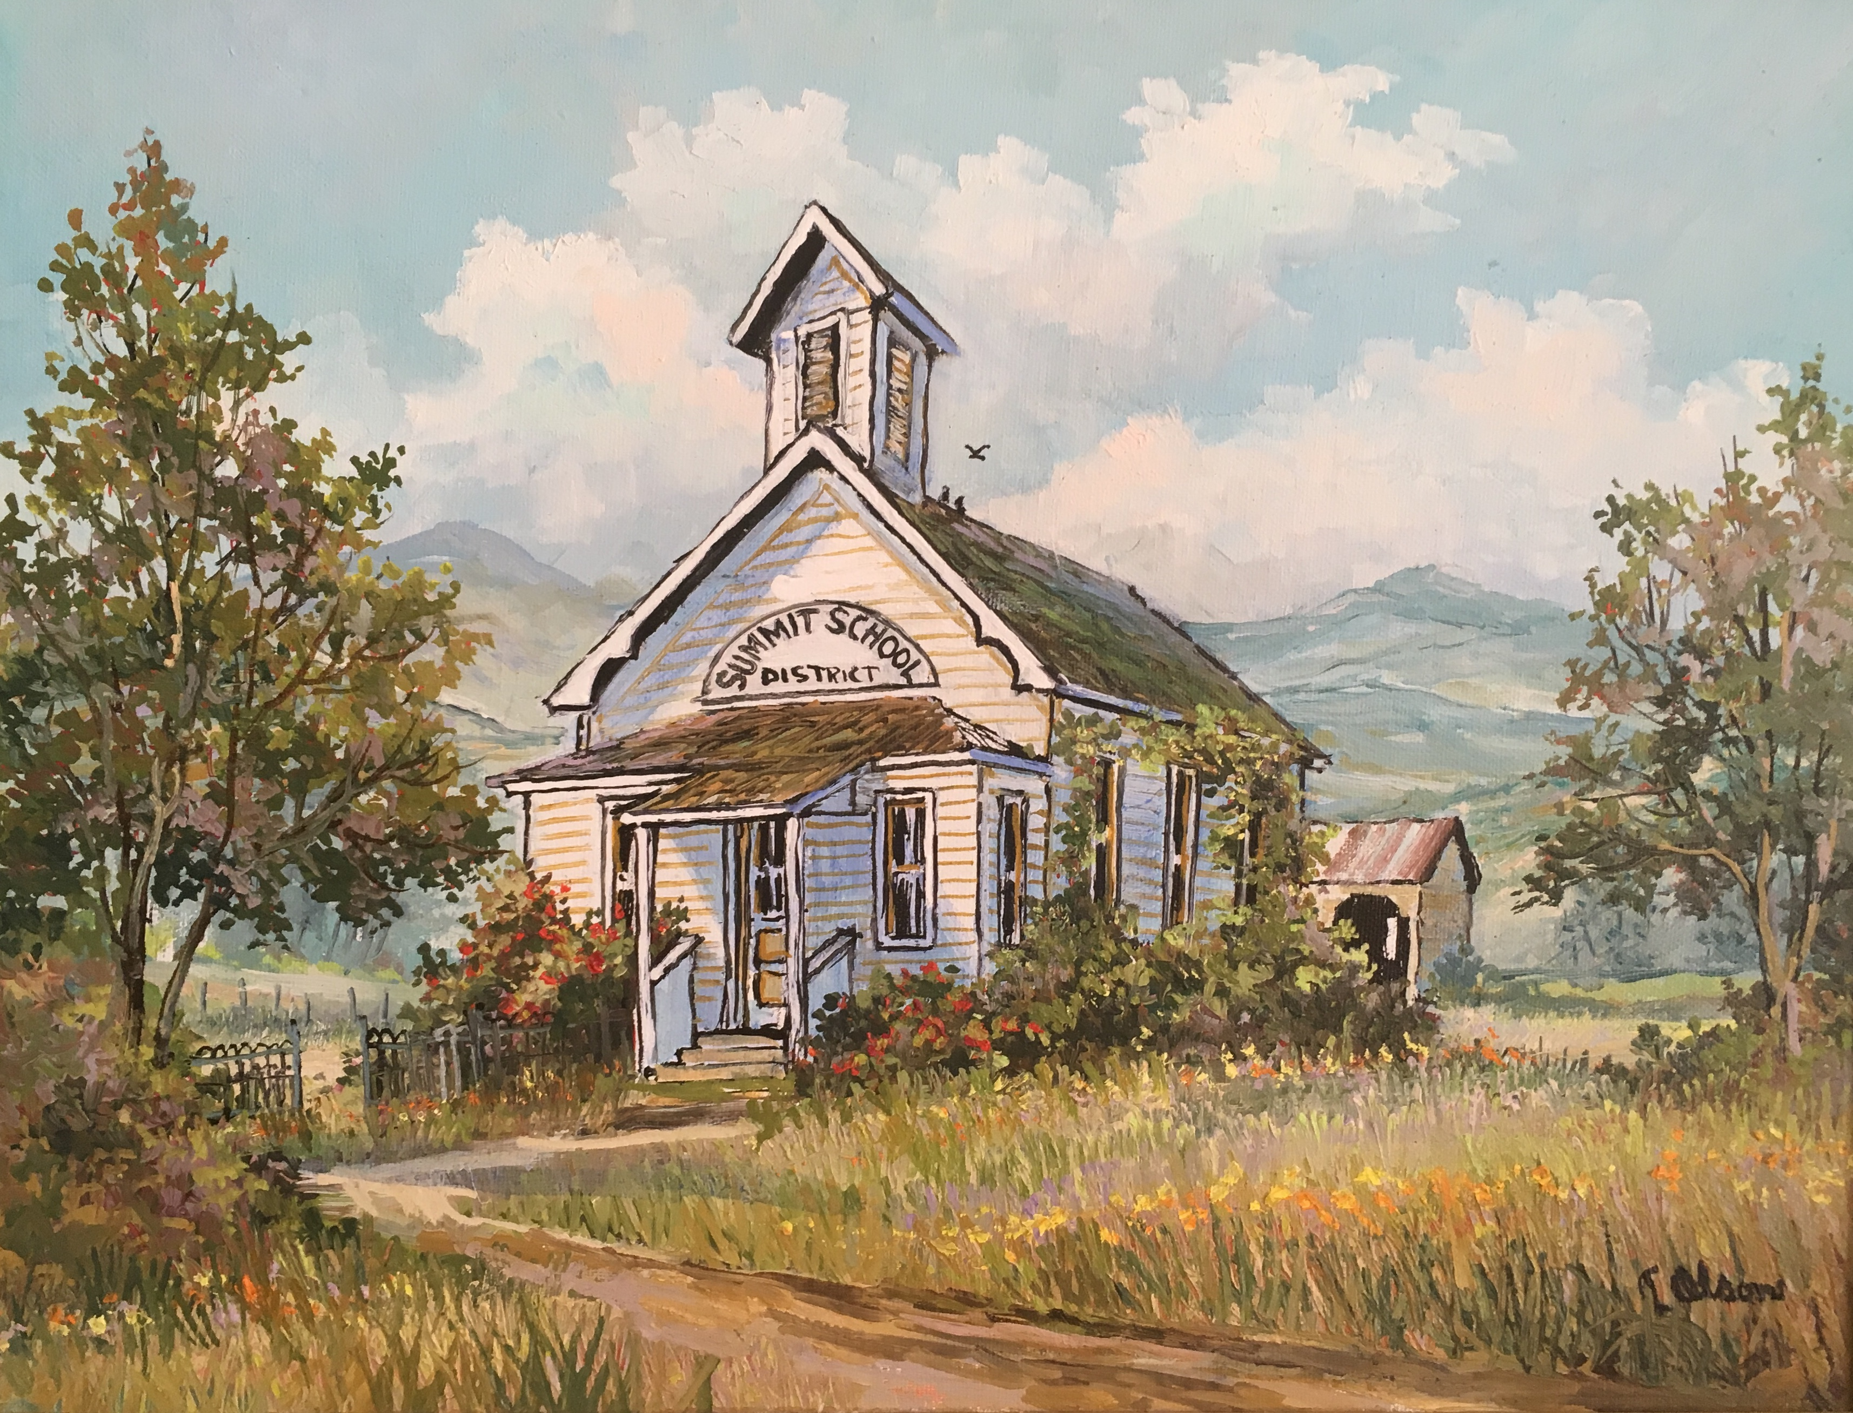
Planning Steps
Request and process data
Protect our culturally rich curriculum
Focus on pedagogy
Notes:
List planning steps your program is planning to take within the next year (or so). These would be found in your Annual Unit Plan.

