Slide 1
Astronomy, Physics, Physical Science
Program Review Presentation
Cohort 1: 2018-2019

Slide 2
Astronomy, Physics, Physical Science Profile
GE Courses
ASTR: 300 (Intro to Astronomy), 310 (The Solar System), 320 (Stars, Galaxies, and Cosmology), 330 (Introduction to Astrobiology), 400 (Astronomy Laboratory), 481 (Honors Astronomy: Stars, Galaxies, and Cosmology lecture/lab)
PHYS: 310 (Conceptual Physics), 311 (Basic Physics), 312 (Conceptual Physics Laboratory), 350 (General Physics lecture/lab), 360 (General Physics lecture/lab), 410 (Mechanics of Solids and Fluids)
PS (being deleted): 300 (Introduction to Physical Science), 301 (Physical Science Laboratory)
Notes:
Describe what your program does and how this fits with the mission of ARC

Slide 3
Astronomy, Physics, Physical Science Profile
Sequences
Algebra/Trigonometry-Based Physics (PHYS 350, 360)
  For majors in life science, including most pre-health fields
Calculus-Based Physics for Scientists & Engineers (PHYS 410, 421, 431)
  For majors in computer science, engineering, math, or one of the physical sciences
Degrees
A.S. in Physics for Transfer (AS-T) degree
Part of Physical Science/Mathematics A.S. degree
Part of General Science A.S. degree
Notes:
Describe what your program does and how this fits with the mission of ARC

Slide 4
Astronomy, Physics, Physical Science Profile
Contributions to ARC mission - To place students first in providing an academically rich, inclusive environment:
Many course options for courses students of nearly any major to take to meet ARC GE requirements, and/or CSU and IGETC transfer requirements
Increased students’ scheduling options by offering:
  Online: ASTR 300 and PHYS 310 online
  Hybrid online/in-person: PHYS 350 (others coming soon!)
Foundational STEM courses for many majors
Critical thinking and learning as integral processes in each course
Responsible participation in the community increased through scientific literacy
Notes:
Describe what your program does and how this fits with the mission of ARC

Slide 5
Astronomy, Physics, Physical Science Profile
Contributions to ARC mission - To help serve the greater Sacramento region:
Clear pathway to CSU physics degree for students who earn Physics AS-T degree
Strong foundation for transfer for students who earn one of our shared degrees (Physical Science/Mathematics A.S. degree, or General Science A.S. degree)
Advancement of academic, career, and personal goals for students who take our courses and/or earn our degrees
Notes:
Describe what your program does and how this fits with the mission of ARC

Slide 6
Historical Analysis - Data
Program Challenges:
Enrollment: We are not as effective as desired in attracting:
  Hispanic/Latino or African American students
    Particularly to our physics courses
    Somewhat to our astronomy courses
  Asian students to our astronomy courses
  Female students to our calculus-based physics series
Disproportionate Impact: We are not as effective as desired in helping African-American and Hispanic/Latino students succeed in our physics courses.
    Particularly in PHYS 410, a “gatekeeper” course that keeps these students from being able to pursue physics, chemistry, engineering, or computer science degrees
Notes:
List your program’s strengths and challenges based on review of your historical data or other records.

Slide 7
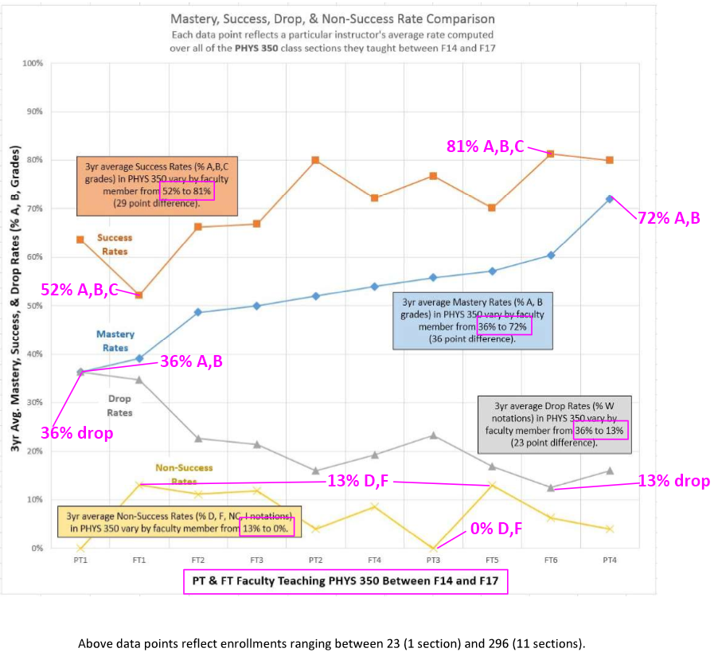
Historical Analysis - Data
Program Challenges:
Grading Variability in PHYS 310, 350, and 410:
  Large differences in how instructors assign final grades in PHYS 310, 350, and 410
Notes:
List your program’s strengths and challenges based on review of your historical data or other records.

Slide 8
Historical Analysis - Data
Program Strengths:
Productivity
  Stable in physics
  Slight drop in astronomy
    Attributable to program changes which have contributed to better student success
    Therefore no cause for concern
Department Set Standards
  Meeting or exceeding department set standards in all courses
Notes:
List your program’s strengths and challenges based on review of your historical data or other records.

Slide 9
Historical Analysis - General
Program Strengths:
Faculty professional development activities, including:
  AAPT conferences
  ARC Physics Lecture Series
Community and campus outreach:
  Physics and Astronomy club
  TRIO SSS STEM Olympics
  Eclipse viewing
  STEM center office hours
New honors astronomy course, ASTR 481: Honors Stars, Galaxies and Cosmology
Lab and demo equipment and technology up-to-date
New STEM building (Woohoo!)
  Classroom improvements
  Additional lecture classroom is a step toward increasing our class section offerings
Now in the hiring process for a new full-time physics/astronomy faculty position
Program Challenges:
Astronomy observatory/dome is still needed for use in night labs
  Permanent mounting of larger telescope(s)
  Improved productivity of more complex tasks, especially in honors ASTR 481
Office space
  New full-time faculty member
  Many part-time faculty members
Notes:
List your program’s strengths and challenges based on review of your historical data or other records.

Slide 10
Objectives
Enrollment – Achieve student population in our courses that better reflects the overall population of ARC.
  Supports ARC’s mission of equity-minded education
Disproportionate Impact - Eliminate disproportionate impact on African-American and Hispanic/Latino students in physics, particularly PHYS 410.
  Promotes the inclusive environment called for in ARC’s mission
Notes:
List what your program wants to accomplish. Discuss how these accomplishments will or do support the ARCmission.

Slide 11
Objectives
Grading Variability in PHYS 310, 350, and 410 - Reduce variability between instructors in how final grades are determined, starting with PHYS 350 and 410.
  Increases ARC’s institutional effectiveness if:
    All students who are gaining sufficient mastery in these courses are allowed to progress.
    Students who are not mastering the material in these courses are required to do so before moving on, so they will be able to succeed in their subsequent classes.
Notes:
List what your program wants to accomplish. Discuss how these accomplishments will or do support the ARCmission.

Slide 12
Strategic Enhancement
To increase enrollment of and reduce disproportionate impact on students from underrepresented groups (esp. in PHYS 410), we desire to:
Outreach
  Reach out to and connect with these students, so they are familiar with our courses and faculty members.
  For example: Outreach to learning communities on campus, such as the TRIO STEM program.
Support
  Take steps to make sure these students, upon enrollment, feel supported, and that they belong, especially in the more difficult courses, like PHYS 410, where group work and networking are crucial to success.
  For example: Professional development activities for our faculty members, such as training in how to better help students by making proactive interventions early in the semester.
Notes:
Describe what your program’s ideal future looks like. Discuss how this vision supports ARC’s commitment to social justice and equity.

Slide 13
Strategic Enhancement
Doing this (increasing enrollment of and reducing disproportionate impact on students from groups underrepresented in physics) will support ARC’s commitment to equity-minded education in an inclusive environment by:
Giving these students the same educational opportunities that other students have
Helping give all of our students the opportunity for equal outcomes
Notes:
Describe what your program’s ideal future looks like. Discuss how this vision supports ARC’s commitment to social justice and equity.

Slide 14
Strategic Enhancement
To reduce grading variability, especially in PHYS 350 and 410, we desire to:
Review and/or revise course outlines, including the SLOs.
Discuss and create a set of best practices for some courses.
Look for opportunities to support and coordinate with part-time and/or LTT faculty teaching these courses.
This supports ARC’s commitment to equity-minded education in an inclusive environment, helping give all of our students the opportunity for equal outcomes, independent of the instructor taken for a course.
Notes:
Describe what your program’s ideal future looks like. Discuss how this vision supports ARC’s commitment to social justice and equity.

Slide 15
Planning Steps
Reach out to the TRIO STEM program which serves the students we would like to recruit to our classes.
  This program has access to these students, and is set up to help them accomplish their educational goals.
  Participating in TRIO STEM’s Summer Bridge program would allow us to connect with these students before fall semester classes start.
  We could maintain these connections and support these students if a faculty member is assigned to work with TRIO STEM throughout the academic year.
  The details would need to be worked out with the TRIO STEM coordinators.
  We’ve already begun to meet with them!
Notes:
List planning steps your program is planning to take within the next year (or so). These would be found in your Annual Unit Plan.

Slide 16
Planning Steps
Revise the SLOs for PHYS 350 and 410 to be more specific, to identify topics most critical for success in subsequent courses.
  This is a first step to be followed in future years by:
    Creating set of best practices for these courses
    Creating a more effective support system for part-time and or LTT faculty teaching these courses
Notes:
List planning steps your program is planning to take within the next year (or so). These would be found in your Annual Unit Plan.

