Slide 1
ARC General Counseling Department Program Review
Fall 2020

Slide 2
Unit Profile
1.1 Briefly describe the program-level planning unit. What is the unit's purpose and function?
ARC Counseling provides students with personal and academic counseling to help students achieve their academic and career goals. The counseling faculty and support staff of the counseling center are dedicated to providing quality services to all students including new, continuing, returning and potential students. We provide: Academic Counseling, Career Counseling, Personal/Crisis Counseling; Instruction: Human Career Development Courses; The Counseling Department is committed to meeting the multifaceted needs of students in an environment that recognizes the diversity of our student body and values the worth and dignity of each student. We work collaboratively with instructional faculty, administrators, and college staff to ensure a seamless delivery of services that cultivate and encourage student success.
1.2 How does the unit contribute to achievement of the mission of American River College?
American River College, serving the greater Sacramento region, offers education and support for students to strengthen basic skills, earn associate degrees and certificates, transfer to other colleges and universities, and achieve career as well as other academic and personal goals. The counselors are integral in this mission in guiding and supporting students through their educational journey. ARC Counselors are committed to supporting the emotional, social and intellectual development of all students. The Counseling Center provides a wide range of counseling services that support students in resolving personal challenges and acquire the skills, attitudes and abilities that will enable them to successfully reach their education and personal goals.

Slide 3
Assessment and Analysis
Consider progress over the past five years. Based on how the unit intended to measure success, did the planned action steps result in intended effect?
  Special Programs undergo their own evaluation
  Counseling Services Evaluation
    Evaluate and improve programs and services based on established procedures.
  Training
    Crisis intervention training
    Monthly Counseling Training
  Online Delivery Systems
    Evaluation and Creation of online forms
  Increase participation on committees, grants and projects
  Increase FTE in Counselor participation of HCD courses

Slide 4
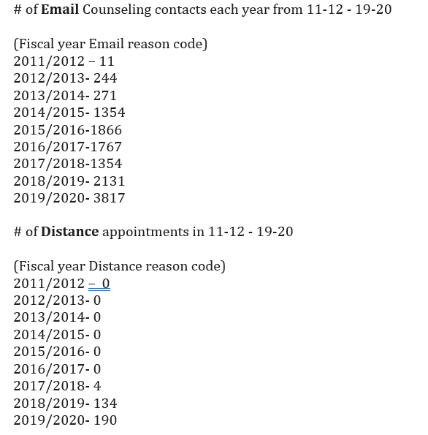
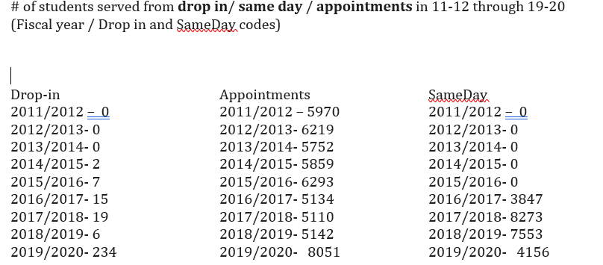
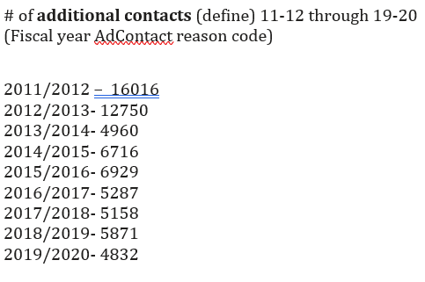
SARS DATA

Slide 5
Analysis
Analyze data over last 5 years (survey results from 2019 and SARS Data) – what were findings?
  Mostly female students complete the survey (79% female)
  Most student prefer scheduled appointments (85%)
  Most students would like to see a counselor to explore career, plan required course and graduate.
  Most students felt the counselor was helpful, listened and provided clear explanations.
  Most students would prefer to see the same Counselor each time they have an appointment.
  In general many students thought the wait time for a drop in appointment was too long.
  Student would like an easier way (online) to book appointments.
Identify strengths, opportunities, influencing factors, challenges, equity gaps, data limitations, areas for further research/ or other.
  Opportunities to explore equity gaps and alternative ways to assess student satisfaction with counseling services.
  Strengths
    Counseling department is committed to evaluating and improving our programs and services based on campus and district wide established procedures.
    Counseling has undergone many changes with implementation of Achieve and Homebases in the last three years in response to ARC’s redesign and a national COVID-19 pandemic. Counselors welcome opportunities to partner with instructional faculty and administration to help increase student success.
    Counselors stay informed and updated on statewide educational initiatives, campus programs and services, transfer programs and services, resources, and career opportunities available to students.
    Students mostly feel satisfied with their experience after meeting with a Counselor, they feel informed and listened to.

Slide 6
Reflection and Dialogue
What did your unit learn from the analysis and how much the relevant findings inform future action?
  From SARS and Survey Data we are seeing an extreme increase in online contacts, we are definitely in a time to increase and improve our website and online services to provide clear, relevant and accurate information and our availability to meet with students virtually.
What is the units ideal future and why is it desirable to ARC’s mission?
  Equity and inclusion in a remote environment – examining how can we serve better serve students with greatest needs.
  Update website, user friendly – clear and easy instructions for students to book appointments and receive a confirmation email and text.

Slide 7
Strategic Enhancement
Define one or more program level objectives which enhance units effectiveness.
  From our 19-20 Annual Unit Plan
    Case Management
    Data Informed Approach (peak week data – use data to inform service delivery)
    Equitable Support Services (easy to navigate web site, include photos or more visual)
What does your unit intend to work towards the ideal future, how will success be measured?
  Figuring out a way to measure outcomes based on effective counseling models.
  Planning future training based on outcomes and need.
  Using data to better plan department general function and implement new services.
How will the intended enhancements support ARC’s commitment to social justice and equity?
  With better planning of service delivery Counselors will be more available for students most in need.
  Invest resources in different ways – look at data – who do we see, when, how many units? How do we spend most of our time? Are we serving students who already successfully navigating this system.
  Case Management utilizing technology – targeted early interventions with students

Slide 8
Thank you!
Questions?
Reyna Moore
Counselor, Department Spokesperson

