Slide 1
Work Experience and Internship Program
Program Review Presentation
Cohort 3: 2021-2022

Slide 2
Work Experience & Internship Program Profile
The Work Experience and Internship Program (WEXP), in compliance with Title 5 guidelines, is a unique academic program that offers students the opportunity to earn academic credit for work based learning, which includes paid work, internship (paid or unpaid), or volunteer work.
There are 3 primary components of the program
Instruction - the classroom instruction focuses on students developing or enhance on-the-job workplace skills, knowledge, and abilities as well as improving and enhancing self and career understanding
Direct Services to Students - Appointments, class presentations, and workshops focused on resume development/enhancement, interview coaching, internship search
Employer Engagement - Internship and volunteer development

Slide 3
Historical Analysis
Program Strengths:
Social Justice and Equity
Program Relevance
Curriculum
Title 5 Compliance
Innovation (Outreach, Direct Services to Students, Design Hub, Music Circus)
Districtwide collaboration
Program Challenges:
Program Identity
Apprenticeship Program connection
Internship opportunities and quality are dependent on employers/marketplace
Data Limitations
Breadth of SME for industry internships
Staffing

Slide 4
Objectives
Students first by continuing to:
  Develop internship opportunities with a focus on paid internships
  Annual Unit Planning
Clear and Effective Paths by continuing to:
  Collaborate with Career Education programs
  Update curriculum
  Monitor employment and workplace trends and demand
  Use of data to inform program goals

Slide 5
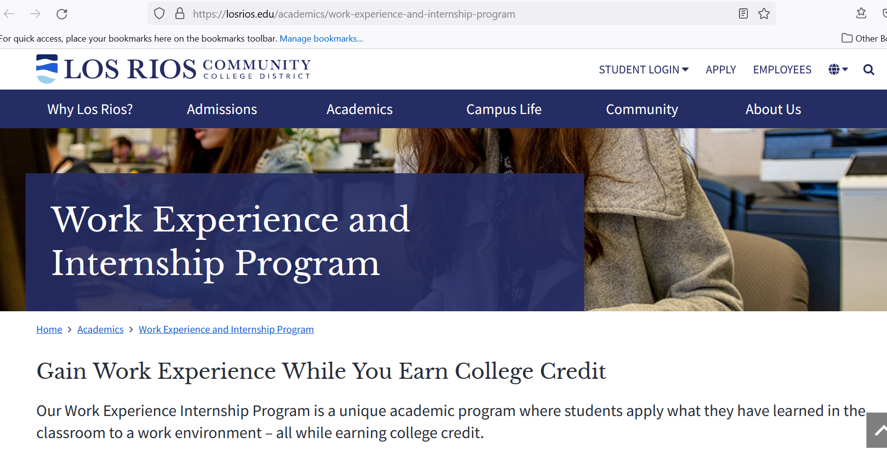
Strategic Enhancement
Handshake
  Data
  Ongoing training
  Marketing campaign
Social Justice And Equity
Culture add framework
Emphasis on paid internships
Meta-majors/Homebases
  Use Homebase structure as grounding
  Awareness of virtual internship opportunities
Event Modalities
Hyflex

Slide 6

Planning Steps
Continue with efforts to
  Explore/innovate engagement with students
  Elevate serving DI students
  Handshake utilization
  Title 5 Update

