Slide 1

EOP&S/CARE/NextUp, ARC
Program Review Presentation
Cohort 3: 2021-2022
Extended Opportunity Programs & Services
Cooperative Agencies Resources for Education
Cooperating Agencies Foster Youth Educational Support
(NextUp)
Above, Beyond, and In Addition to…

Slide 2
ARC EOP&S/CARE/NextUp Profile
State funded program established in 1969 by the California State Legislature
Case management counseling program: Encourages enrollment, retention and transfer; completion of educational goal for low-income and educationally disadvantaged students
Los Rios Colleges; ARC allocated to serve 1,286 students
“Above and Beyond, and in addition to…” Orientation, three counseling contacts per semester, priority 0 enrollment, book grant, tutoring services, workshops, transfer services, monthly resources (*CARE and NextUp)
2021-2022 Allocations: serve 1,283 students, $1,616,931 dollars, $287,714 textbook expenditures
4 permanent counselors, 5 adjunct/part-time counselors, 5 classified, one temporary classified, 5 student staff, one coordinator
Notes:
Describe what your program does and how this fits with the mission of ARC

Slide 3
EOP&S/CARE/NextUp Profile, who we serve
EOPS: serve low-income and educationally disadvantaged students by providing academic support services to assist students in achieving their educational goals.
CARE: To assist single-parent EOPS students, receiving county aid, to overcome the obstacles of single parenthood in order to succeed in college and help expand their educational and job training opportunities.
NextUp: To serve current or former foster youth who were or are ward of the courts before or after age 13;

Slide 4
ARC EOP&S/ CARE/NextUp
Cycle
Enrollment, Retention, Completion
Staff Training & Support
(Ongoing)
Recruitment: Intake & Eligibility (Pre-semester)
Specific Intentional Services (Semester)
Semester Ending
Advisory Board
MIS-Data Reporting

Slide 5
ARC EOP&S/CARE/NextUp Cycle
1. Recruitment: Intake & Eligibility (Pre-semester)
Outreach on and off campus
Collaborate with campus departments
Identify eligible participants
Complete EOP&S Orientation (HCD 115 and/or EOP&S Canvas)

Slide 6
ARC EOP&S/CARE/NextUp Cycle
1. Recruitment: Intake & Eligibility (At Start of Semester), cont.
Mutual Responsibility Contract (MRC) for each new participant
Collaborate with DSPS, CalWORKs, * FA and A & R
Entry: Database, Peoplesoft, SARS for orientation
SARS: counselors schedule, appointments, alerts
Process Textbook Grant (Business Services Office)

Slide 7
ARC EOP&S/CARE/NextUp Cycle
2. Specific Intentional Services (Semester)
Counseling: education, academic, personal short-term crisis, referrals; ISEP and/or referrals for careers/majors
Student Services Resource Center: Tutoring, drop-in, one on one, MSP
Workshops: personal, career, academic, study skills
CARE/NextUp participants: monthly resources, mid and end of semester grant
*EOP&S Zoom/on ground office (“open door” visits)

Slide 8
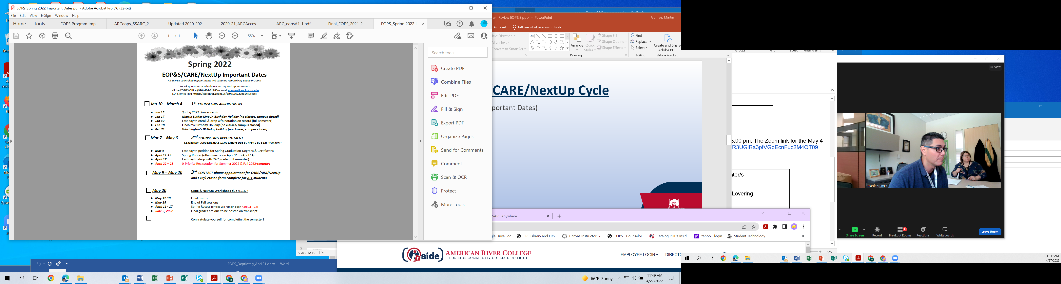
EOP&S Appointment Schedule Guide
(Spring 2022 sample: Important Dates)

Slide 9
ARC EOP&S/CARE/NextUp Cycle
3. Semester Ending (Near End of Semester)
Priority “0” Registration
EOP&S/CARE/NextUp 3rd Contact Exit Form & Petition
End of Academic Year Student Celebration: Curbside Celebrate Graduates
4. Advisory Board: CalFRESH, WEAVE, community members (Social Workers, Sacramento County Office of Education, County Offices)

Slide 10
ARC EOP&S/CARE/NextUp Cycle
5. MIS-Data Reporting-Case Management Approach
New student must have file containing required documents (Google Account):
  EOPS Application, Income verification and Educational factor, Educational Plan, Units enrolled, Mutual Responsibility Contract, *DSPS unit waiver
  “served” means student must attend at least one class session during the term.
  Collaborate with the college’s MIS staff to determine class attendance.

Slide 11
ARC EOP&S/CARE/NextUp Cycle
6. Staff Training and Support (on going)
During Remote Services, EOP&S Zoom Office
Bi-monthly Department Meetings with faculty counselors and classified: invite on and off campus guest speakers
Bi-weekly student staff meetings
Announcements: Webpage, Canvas, emails, phone calls
CCCEOPSA Annual Conference, Spring Training

Slide 12
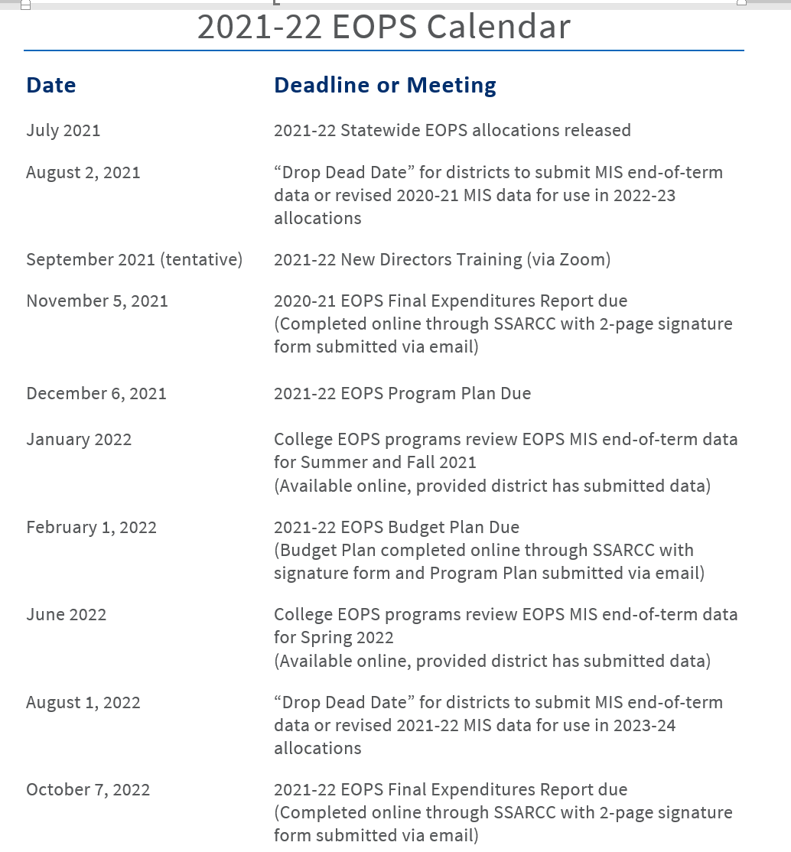
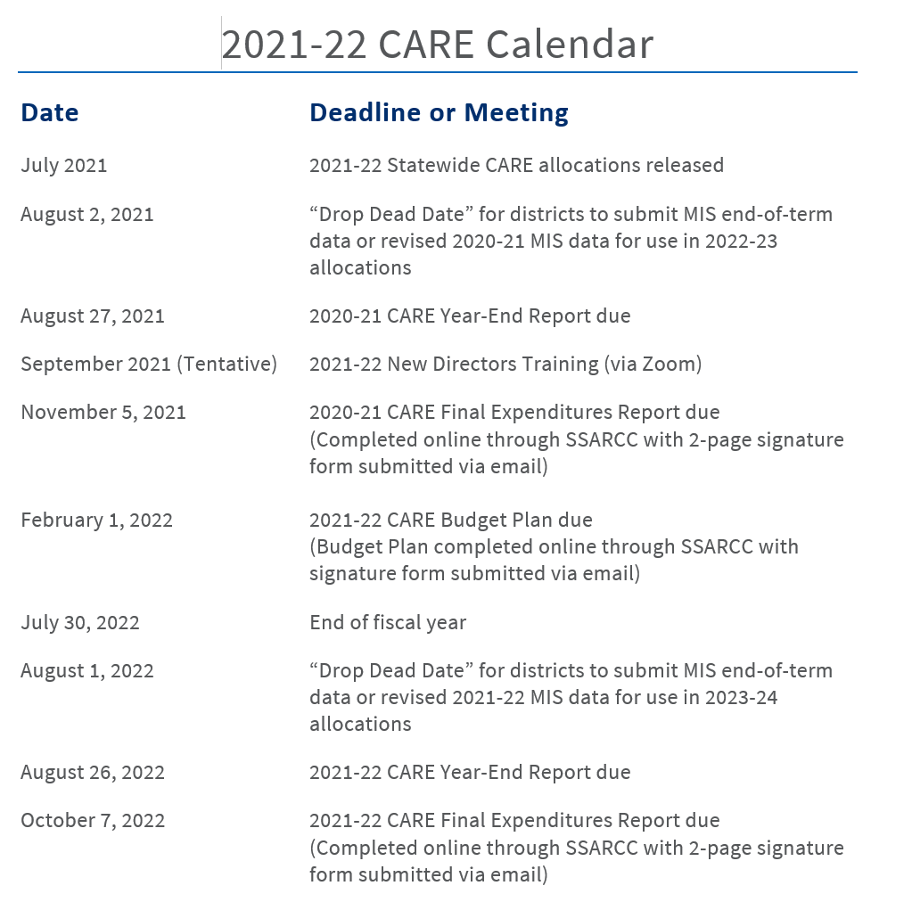

Slide 13
Historical Analysis
Program Challenges:
Allocation concerns
Reduction of students served * Fall 2019 to Spring 2022
Tracking transfer paths and enrollment to bachelor earning institutions
Retention of students
Guidance on personalized data analysis for evaluation and improvements (practitioner based)
Effective outreach practices on campus and off-campus partners
Improvements of data tracking
 | Fall 2019 | Spring 2020 | Fall 2020 | Spring 2021 | Fall 2021 | Spring 2022
New students: | 361 | 268 | 212 | 161 | 235 | 138
Continuing: | 651 | 734 | 772 | 790 | 707 | 687
All: | 1,012 | 1,002 | 984 | 951 | 942 | 825
Notes:
List your program’s strengths and challenges based on review of your historical data or other records.

Slide 14
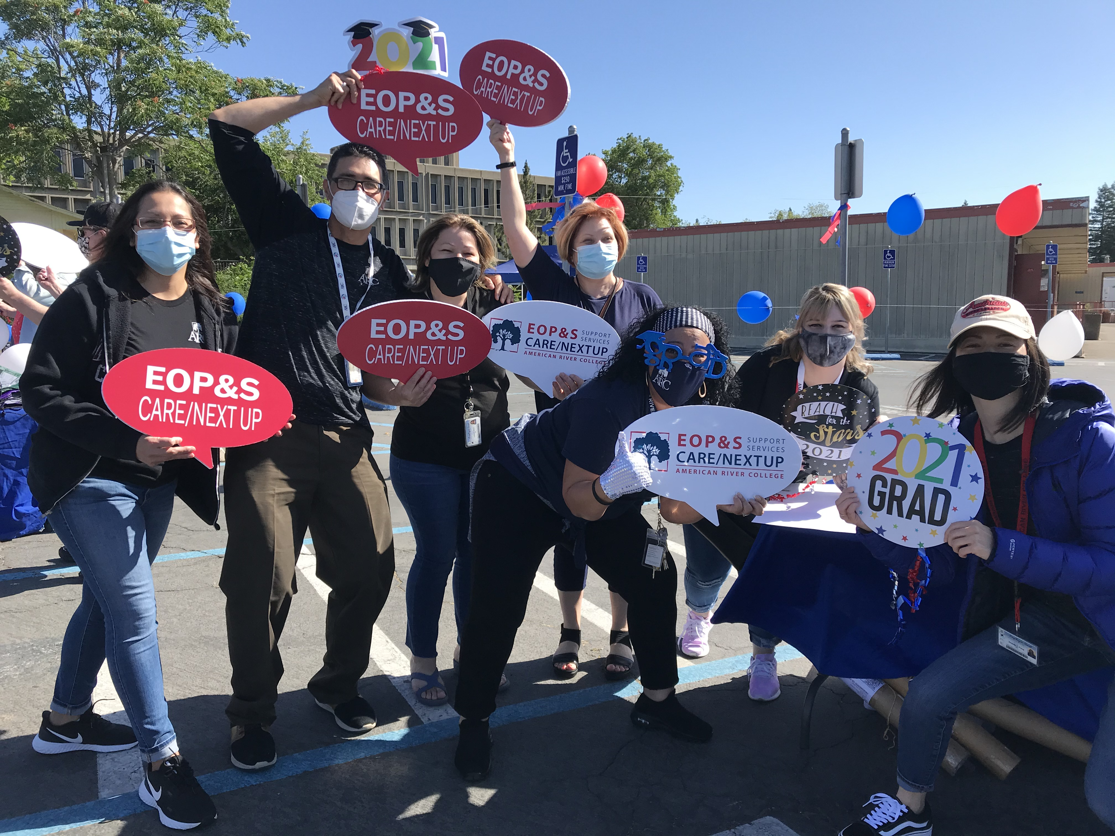
Further Data
In the Fall of 2018, 1,024 students were served; 810 (74%) completed three EOP&S contacts
In the Fall of 2021, 942 students were served; 720 (76%) completed three EOP&S contacts
Fall 2020 semester: a total of 984 students were served, 52 were CARE participants, and 37 were NextUp.
Spring 2021 semester: a total of 951 students were served, 55 were CARE participants, and 40 were NextUp.
  EOP&S textbook grant $350. CARE and NextUp participants supply grant of $50, monthly resources, a mid-semester and end of semester grant.
Spring 2021 semester, a drive-through Student Celebration was conducted by all categorical programs, where more than 80 participants.
Notes:
List what your program wants to accomplish. Discuss how these accomplishments will or do support the ARCmission.

Slide 15
Strategic Enhancement/Planning Steps
Sustain, improve, and enhance campus and community partnerships -Advisory Board for recruitment purposes
Establish best practices among counseling colleagues for services delivery and retention efforts
Work with surrounding higher education institutions for transfer services and CCC Guided Pathways
Strategies for DI populations (ie undocumented/AB 540 students)
Ongoing support and guidance from campus departments, Department Dean, and other categorical programs
Notes:
Describe what your program’s ideal future looks like. Discuss how this vision supports ARC’s commitment to social justice and equity.

