Slide 1
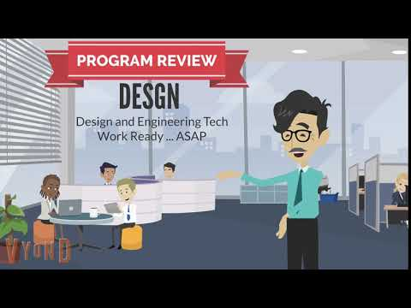
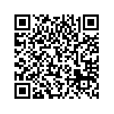
DESGN
DESIGN & ENGINEERING TECHNOLOGY
Program Review Presentation
Cohort 2: 2019-2020
PREPARED BY: SCHUSTER
Link to google slide presentation
https://docs.google.com/presentation/d/18OyFcVo1HVS7MBR6WtvVr2VTx3aczjzR-QbLVbkLw-M/edit?usp=sharing

Slide 2
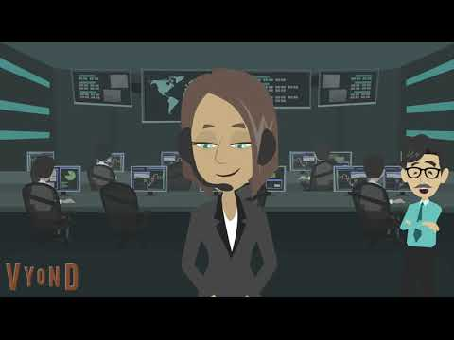
DESGN Profile
Immediate & direct employment is our primary objective. Most graduates obtain an entry level job as a drafter / designer supporting the architectural, civil, and mechanical engineering professions. Many do so prior to completion of the program.
Emerging technologies such as Virtual Reality, 3D Design Coordinations, Generative Design, and Applied Drone Technology provide cutting edge training for our students who wish to stand out to local employers.
A portfolio of work is created for each course, and is a key strength of the program because the portfolio is the key to the interview process.
Our Faculty is made of a diverse group of professionals. We value their experiences in order to provide students in our program with the opportunities to develop their technical and artistic design capabilities, and to engage in critical and creative thinking as they solve complex design problems, (3) participate in lifelong learning as they build the ability to learn new skills through research, (4) succeed in a competitive global work environment as they excel in the latest
skills, techniques,and methods used in the local design industries, and
(5) exhibit responsible citizenship benefit society as well as themselves as
they practice professional ethics and principles of quality management.
Notes:
Describe what your program does and how this fits with the mission of ARC

Slide 3

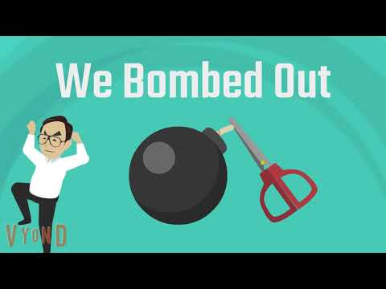
Historical Analysis
Program Strengths:
We strive to utilize innovative, high-quality instructional methods and technologies
provide training in cutting edge technologies
  In this respect, our department has excelled as evidenced by our integration of drone data acquisition, Virtual Reality, and computational analysis into our everyday lessons and assignments. Our development of Building Information Modeling (BIM) is continuing with new and improved technologies (Dynamo).
personalized, proactive support
  In this respect, our department is strong as shown by our list of recruitments ... many of which we are not able to fill due to the small number of students in our program. A major part of this was our success in providing Design Hub internships for our students who were then able to translate that experience into jobs upon (or before) graduation.
Program Challenges:
Enrollment:
our enrollments are slightly down (3% - 4%) on the short term and significantly down over the long term
Productivity:
Our productivity shows a significant decrease, but this is partly due to the fact that our DESGN 498 WEXP course does not fully account for the multi-unit students who bring the productivity much higher.
DI Groups:
Our data is poor for our African American students.
Curriculum:
Our 2nd year courses are out of
balance (unit wise) and cause
a heavier workload on our
students than is necessary.
Advances in CADD technology
allows us to reduce this unit
load.
Notes:
List your program’s strengths and challenges based on review of your historical data or other records.

Slide 4
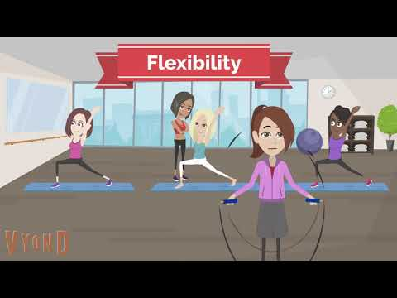
Objectives
Flexibility is key in order for our students to attain their educational goals in a timely manner.
Our primary goal is to provide a pathway to a degree or certificate that is based on
demonstrated skills and work based learning.
Provide flexibility in assessing the student's demonstrated attainment of required skills
Provide an "0n Campus" work based learning platform to serve those students who are unable to meet "Off Site" work experience requirements. This objective will require collaborative work with the DESGN faculty, AS Curriculum Committee, and the administration.
Success will be measure by -
Creation of a reasonable pathway to achieve this goal that is formalized through curriculum and our faculty teaching assignments
An increase in enrollments in DESGN coursework
Improved performance for our DI groups
Notes:
List what your program wants to accomplish. Discuss how these accomplishments will or do support the ARCmission.

Slide 5
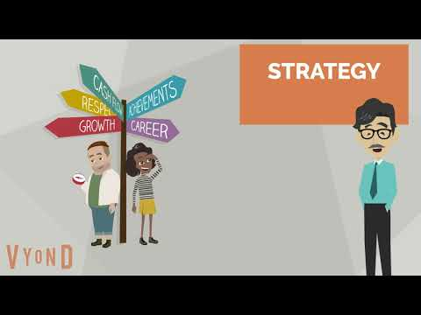
Strategic Enhancement
The stringent lecture / lab system that our department currently has in place can incur strains on unmet and unsupported basic resource needs (shelter, food, access to internet) for some of our disparately impacted students. We need to enact a strategy that will mitigate the effects of unforseen demands on student’s resources and time as they try to overcome unexpected barriers to their educational achievement. One common and glaring instance of this is seen when events conspire to create a situation where a student needs to decide if they should drop a class or to receive an F in the class … both of which could have significant negative impacts on their financial aid status and their progress towards their educational goal.
By being more flexible in how we assess achievement and how we provide units for workplace learning, our students could be allowed to receive the credit that they deserve for the all work that they have completed to date ...
without penalty to their GPA if they are not able to complete
what is currently considered a full class in one semester ...
and with potentially less effect on their financial aid.
Notes:
Describe what your program’s ideal future looks like. Discuss how this vision supports ARC’s commitment to social justice and equity.

Slide 6
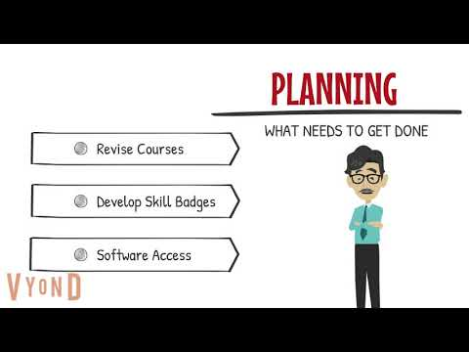
Planning Steps
Revise courses to, where appropriate, split them into smaller units that can be completed in 5 week or 8 week sessions.
  significant ESA allowances will be required to accomplish this
  significant collaboration with the curriculum committee will be required to accomplish this
Develop a robust skill badge system that will provide employers with a good understanding of
  significant ESA allowances will be required to accomplish this
Maintain strong CADD software access for all students
  Significant work with IT will be required to accomplish this
Notes:
List planning steps your program is planning to take within the next year (or so). These would be found in your Annual Unit Plan.

